Slide 1





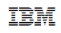









Operational Threat & Risk Information Sharing and Analytics
TEAM Threat

Slide 2
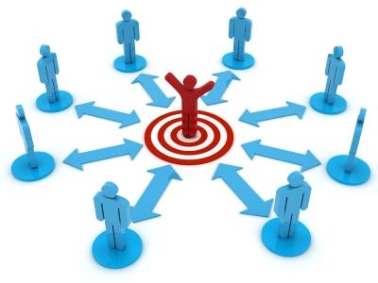
Systems as the bullseye
The focus of our current methods, funding and standards has been the definition, development, security, deployment and operation of systems.
Scope, requirements and success are all with respect to the system.
Vocabulary, concepts, data, processes and behavior are all with respect to the system.
The system is designed.
The system is secured
Such systems are, of course, crucially important – but not the only concern

Slide 3

Our reality today is thousands of systems, interdependent
The problem is less building systems, it is the interoperability and interdependence of systems
Of data
Of processes
Of missions
The methods, processes and standards developed for system building, are not serving us well for this new reality.
But the information, processes and content in “other systems” are critical for each systems mission.
Our new reality is the white space between systems – how they work together
Examples: FIBO, Threat/Risk
Welcome to the white space

Slide 4
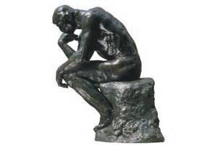
Transition of concerns
How do I build information systems?
How do federate systems and their information for multiple missions?

Slide 5
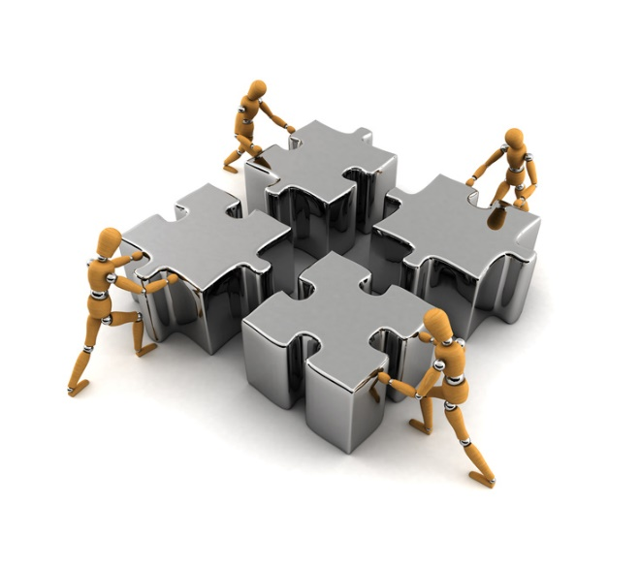
Life in the white space
There are many missions
There are many sets of requirements
There are many viewpoints
There are many vocabularies
There are many technologies
There are many standards
There is no one theory
There is no one design
There is no one authority
Yet, these systems can and must work together. They are dealing with different aspects of the same people, places, things and social constructs.
Often divergent and sometimes conflicting

Slide 6

Is the white space a system?
The methods developed for producing a system provide important capabilities, but also weaknesses when applied to the white space.
Treating the white space as a rigid system becomes fragile, limited and complex
Examples include NIEM, STIX and HL7
But we keep trying

Slide 7
Problems in the white space
Over commitment
Systems techniques applied to the white space tend to over-commit to:
Specific mission or application needs
Specific participants in a community or sub-communities
Specific Terminology
Specific Data structures
Specific Processes
Computational or ontological languages
Implementation Technologies
There will never be “agreement” on one way – our focus must be federation

Slide 8
Symptoms of over-commitment
Point-point solutions
Huge, fragile or skinny and meaningless schema
High overhead and risk for each new system integrated
Anti-agility caused by multiple point-point integrations
Inconsistency in language and interpretation of data
Re-discovery and design of well understood concepts and processes
Complex application-specific rules and restrictions in specifications
Mission specific terms in cross mission specifications
Excessive integration time and costs
Failure of joint operations

Slide 9
Proposition of Semantic Modeling for Information Federation (SMIF)
The “glue” that will bind these diverse missions, applications and data can only be our shared concepts of our shared reality.
Concepts of people, places, things, processes and social constructs
Only these concepts can be the pivot point between these divergent systems with different missions, viewpoints, technologies, schema and application requirements.
These concepts are captured in a conceptual reference model.
The representation of these concepts must not over-commit, but be shared across the potential domains and systems at a level of sufficient agreement and formality for mutual understanding
The same concepts will be formalized in different ways, sometimes seeming incompatible. Formalization and conceptualization are not the same.

Slide 10
Pivoting Through a Reference Model
“Source”
Data
Representation
Data representations (Schema & Instances)
Model data for a purpose using a technology
“Instances” are data structures (e.g. SQL tables or XML documents) – “facts” about the things in the world from some perspective
Conceptual Reference Models
A conception of the world by a group of stakeholders – less purpose specific
“Instances” are things in the world – so can’t be in models
Using abstraction, we can have multiple representations of facts about the world in different data structures and technologies
Rules define how domain concepts can be represented in a particular form – rules can be simple and generic or heavyweight and specific, depending on the representation.
“Target”
Data
Representation
Represent
Rules
Conceptual Domain Models
(Models of the world)

Slide 11
Essential Components
Libraries of shared concepts
(A “lattice of theories”, connected & precise but not monolithic or over-committed)
E.g. Threat/risk concept library & Conceptual FIBO
Capabilities - implementation frameworks able to support, interpret and leverage the models
Conceptual modeling language - sufficient to represent these concepts for both stakeholder engagement and automated processing.
E.g. SMIF Language
Mapping language – able to express how specific data structure patterns represent specific conceptual patterns. E.g. SMIF Mapping language
Mappings to standard, proprietary and internal data structures.
E.g. Threat/risk mappings to STIX & NIEM

Slide 12
Enabled Capabilities
Capability – Synthesis
Ingest and interpret information and processes from multiple divergent sources
Situational awareness
Federated analytics “Connecting the dots”
Joint missions and desperate industries
Capability – Information Brokerage
Translate information between diverse sources and consumers
Capability – Design for interoperability
Instead of designing “from scratch”, use conceptual models as the foundation for new systems. This reduces cost and errors while building in interoperability. Leverages MDA model execution.

Slide 13
Applying SMIF to Operational Threats & Risks

Slide 14
What we need is an integrating framework that supports automated data mapping
Cyber
Crime
Terrorism
IOT &
Critical Infrastructure
Natural
Disasters
Integrating Framework for Threats and Risks
Sharing & Analytics
Sharing & Analytics
Sharing & Analytics
Sharing & Analytics
Sharing & Analytics
An integrating framework that helps us deal with all aspects of a risk or incident
A federation of risk and threat information sharing and analytics capabilities

Slide 15
Situational awareness across cyber/physical threats and risks
Cyber
System Analysis
(Design Time)
Architecture
Design
Assurance
System Focus
Situational Awareness
(Real Time)
Threat information sharing
Threat information federation
Real-time analytics
Information focus
Externally visible subsystems
Vulnerabilities
Attack Vectors
Integrations: UML, UAF, Etc.
Integrations:
NIEM, STIX, EDXL, OGC, SEI, Etc.
Physical

Slide 16
Mission needs
There is a critical need to understand and mitigate threats and risks – to “connect the dots”.
The Landscape of threats is changing
Multiple attack vectors, cyber/physical and other
Advanced threats utilize multiple vulnerabilities
There are multiple communities addressing the same threats
Cyber/physical, emergency management, safety, defense, etc.
No comprehensive consistent semantic framework
Existing systems provide insular treatment of threat/risk relationships
Comprehensive system would allow system-of-systems interoperability (private/private, public/private)

Slide 17
Primary classes of use cases
Transformation from one information sharing data format to another
Example: STIX Cyber Event to NIEM IEPD
Analytics of information federated from multiple sources
Examples:
Fusion center “connects the dots” between a stolen laptop (from NIEM) and a cyber incident (From STIX)
Bio hazard detected by automated instruments and collaborated by local health care professionals

Slide 18
Approach
Highlight O(N) vs. O(N^2)
Construct a conceptual model informed by existing schema, research and best practices
This conceptual model is independent of specific data structures, technologies and terminologies
Define mapping models between the conceptual model and purpose/technology schema
Make both models sufficiently precise that they can drive automated bridging between any mapped schema
The mapping approach complements, rather than competing with, the many exchange formats and technologies. Works with XML, Semantic web and proprietary formats.
Cyber
Terrorism
Cyber
Cyber
Cyber
Disasters
Map/Bridge
Map/Bridge
Map/Bridge
Conceptual Model
Map/Bridge
Map/Bridge
Criminal
Cyber
Criminal
Infrastructure

Slide 19

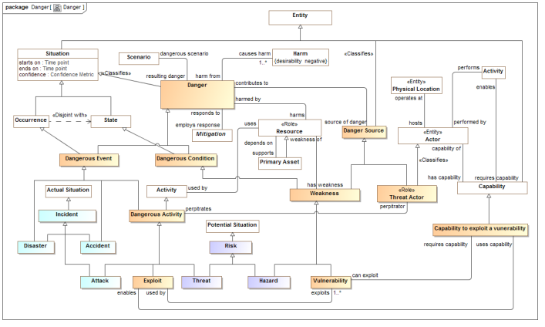
Conceptual Model Inputs
KDM
(Risk)
NIST Framework
Conceptual Model
NIEM
(General)
STIX
(Cyber)
OGC
(Geo)
EDXL
(Emergency)
FIBO (Finance)
SEI
(Safety)
CAL OES
(Health)
MAP
ISO
(Risk)
ISO
(Units)
RMS
(Custody)
STIX, NIEM, EDXL, Others
There is still more to do to fully integrate the above and we anticipate more inputs and use cases

Slide 20
Conceptual Model Packages
Generic Concepts
Abilities
Actors
Assessment
Contact Information
Containment
Control
Credentials
Cyber
Enterprise
Entities
Events and Activities
Identifiers
Intent
Location
Objectives
Observations
Generic Concepts
Organizations
Patterns
Persons
Physical Entities
Places
Policies
Predictions
Processes
Quantities and Units
Resources
Responsible Performers
Rules
Situations
Time and Temporality
Vendors and Producers
Threat and Risk Specific Concepts
Attack/Defense Trees
Campaigns
Danger
Danger Categories
Danger Sources
Incidents and Failures
Indicators
Risk
Risk Treatment
Threat Actors
Undesirable Situations
Vulnerabilities
Weapons

Slide 21
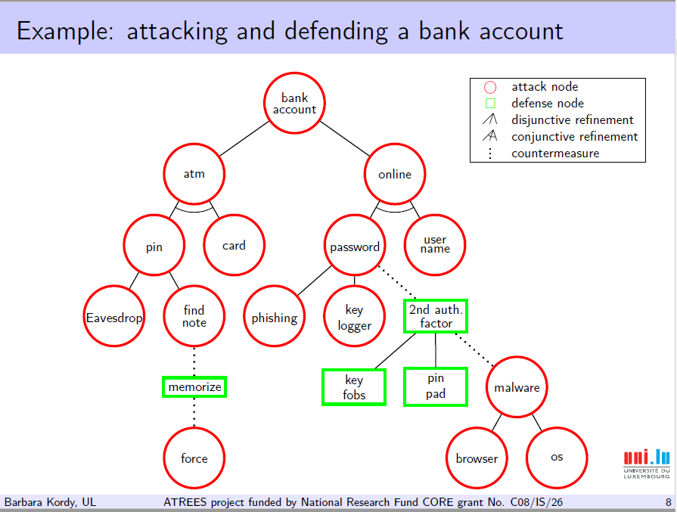
Attack Defense Tree Example

Slide 22
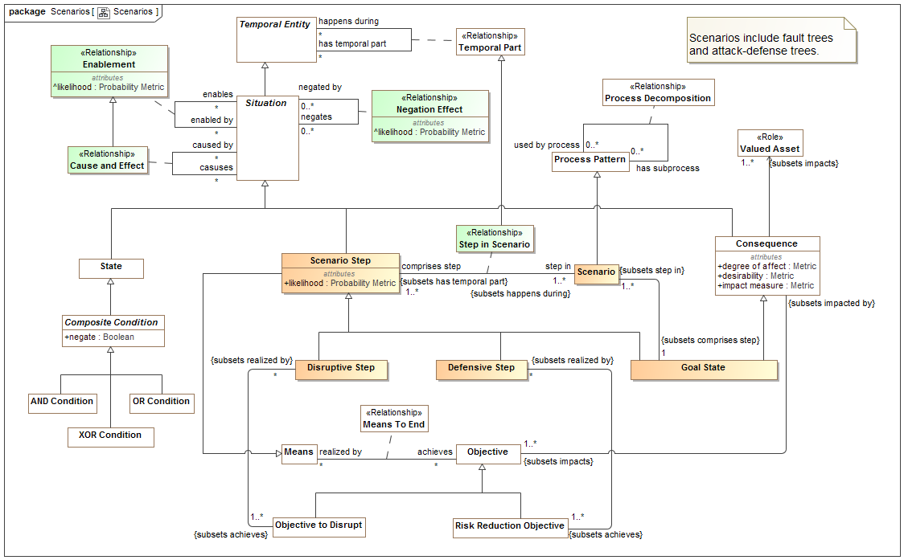
Model Supporting Attack/Defense Scenarios

Slide 23
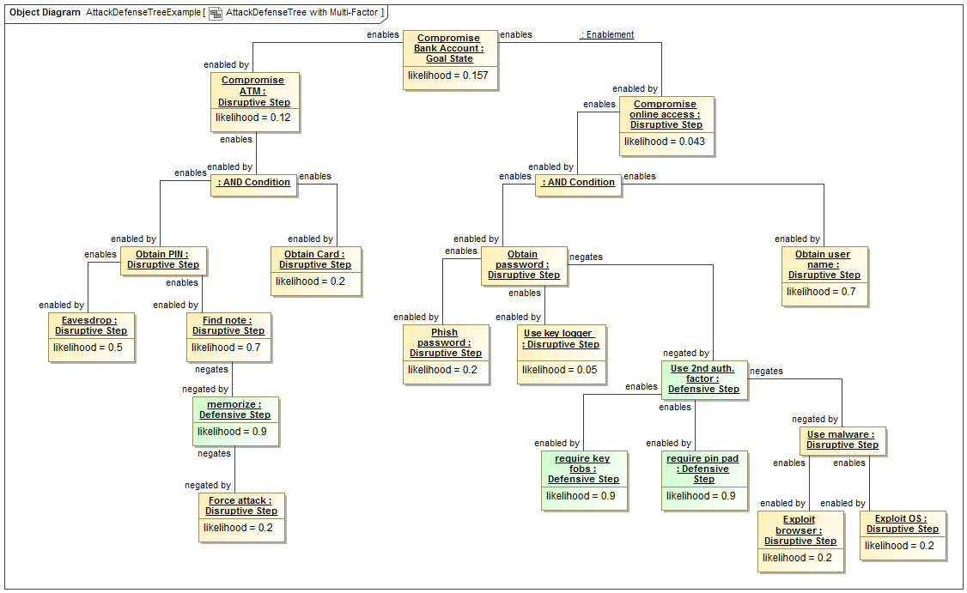
Example mapped to concepts
This is the data - not what a user would see!

Slide 24
Standards to capabilities
What may capabilities based on OTR look like?

Slide 25
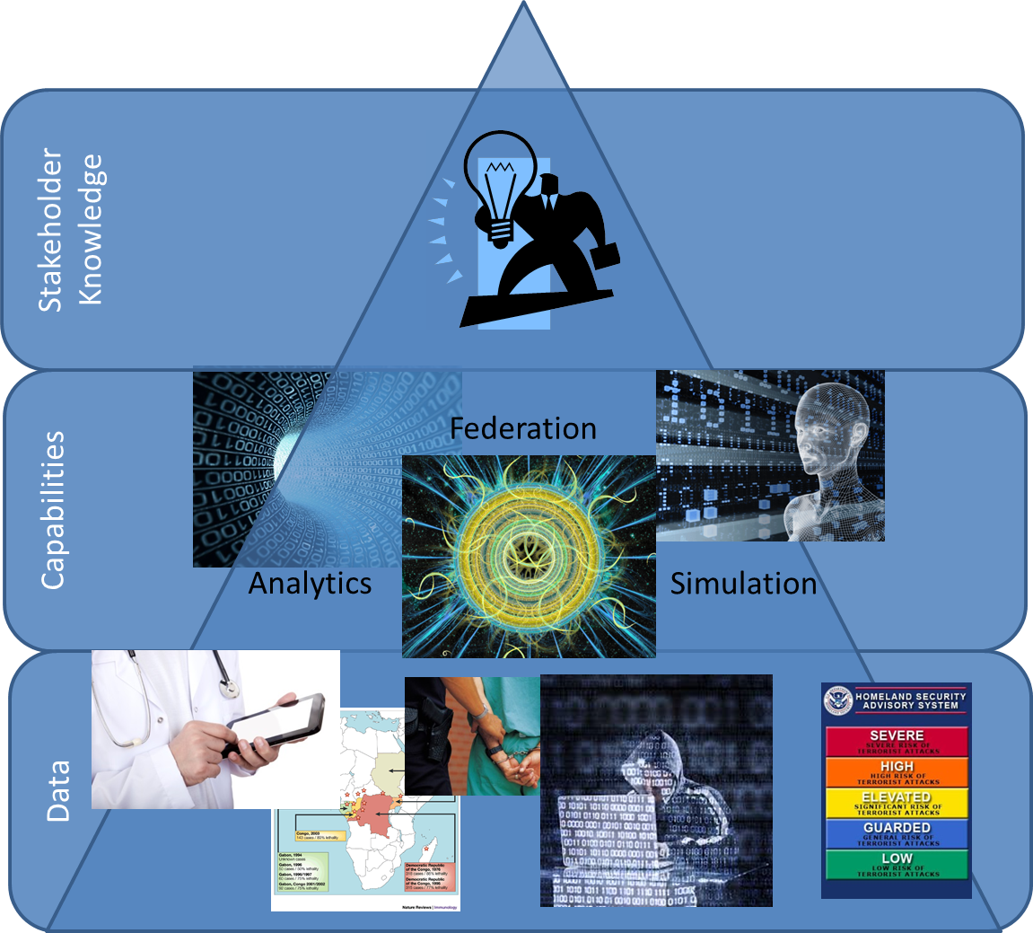
Data to Intelligence
Stakeholder Intelligence

Slide 26
Primary Use Cases
Data Format 1
Data Format 3
Threat / Risk
Data Broker
Data Format 2
Data Format 4
Data Format 2
Data Format 3
Data Format 1
Data Format 4
Threat / Risk
Federation / Analytics
New Knowledge

Slide 27

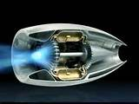
Federation Engine
Federated repository of facts from all sources
Read and write data in a variety of formats and map the data into a data graph repository based on the conceptual models
Federate data from multiple sources such that new facts can be determined though matching entities and advanced analytics
Apply rules to infer new information and map information

Slide 28

Example Gateway
Information
Provider
Provider’s Gateway
Trusted Space
Web Browser
Gatelet
Application
Interface
API
Gatelet
Federation
Engine
Online User
Inerpol
Gatelet
GANG Data
Workflow
others
SQL DBMS
SQL
Gatelet
Rules
NIEM/Global
Gatelet
GANG IEPD
Port
Models
GANG
Data Exchange
Consumer’s Gateway
Consumer
System
Trusted Space
Federation
Engine
NIEM/Global
Gatelet
GANG IEPD
Port
Criminal Data
CSV File
Exchange
CSV
Gatelet
Workflow
Rules
NLET IEPD
Port
others
Models

Slide 29
Technologies to leverage
Semantic information mapping and integration is core
Library of concepts
Mapping technologies
Enhanced graph DB
Rule based
For brokering
Secure endpoint “plugins” for multiple protocols
STIX/TAXII, NIEM/GRA, HL7, Etc
Must be hardened and adaptable
Leverages and uses Analytics Engines
Primarily a “read only” from multiple sources
Requires entity extraction
Need analytics & Visualization engines: Buy/Partner /Build
Capabilities “plug in”
Combination of open source and proprietary

Slide 30

It takes a community!
http://www.ThreatRisk.org
Threat & Risk Information
Sharing Community
Leadership
Information
Sources
Policy
Standards
Tools &
Services
Information Analysts
& Consumers

